Slide 1

Model-Driven development of IoT based Software
School of science and technologies
Degree in computer science (LM-18)
Student: Luca Marasca
ID n: 107104
Supervisor: Prof. Andrea Polini
Co-Supervisor: Dr. Fabrizio Fornari
Academic Year 2019/2020

Slide 2


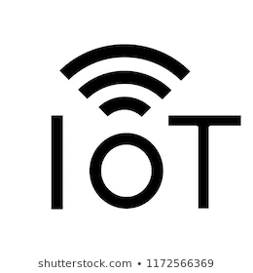


Project overview and objectives
Objectives: Definition of a framework based on Model Driven Engineering to drive business processes involving IoT devices + software tool.
The framework, “BPMN to code”, regards modelling and implementation.

Slide 3
Traditional Approach Main Problems
Project Analyst/Developer→ Produce the Model
Software Developers→ Implements the Tasks
No standard way to represents IoT devices in high-level models.
Implementation deviates from the intentions and expectation of the Business Analyst.
Changing in the model business process part concerning IoT necessitates the adaption or recreation of the implementation.

Slide 4
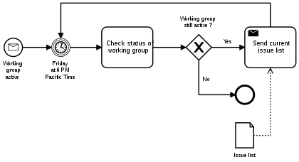

Modeling
Business Process Model and Notation (BPMN) is a standard for business process modeling that provides a graphical notation for specifying business processes in a Business Process Diagram (BPD), based on a flowcharting technique.

Slide 5

Modeling
How to represent IoT in BPMN
There’s the necessity of closing the gap between BPMN and IoT
Two main family of approaches:
BPMN + extensions
BPMN standard
How?
Use of subtasks
Represent IoT in a separate BPMN diagram
Use BPMN in a not standard way

Slide 6

Configuration
Configuration Language
Why do we need a configuration language?
Language structure?
Keyword : value
Keyword = value
Keyword
{
Keyword1 = value1
Keyword2 = value2
}

Slide 7


Configuration
Language Usage
Manage the flow of code
What it’s intended to do in a task:
15 <= TEMPERATURE [LOWTEMP , 2]
_TASK{
DEVICE : "arduino"
NAMEID : "LOWTEMP"
TEMPERATURE{
NAME = "TMP36"
PINS = "0"
SENSOR_ID = "2"
}
}

Slide 8


Translation
BPMN To Code Software Tool
Reduce misunderstanding.
Create a first structure of the code or the intere code.
Reduce significantly the product implementation duration.
The BPMN needs to be structured as the framework implies.
Xtext -> Is a framework for building language workbenches for textual domain-specific languages
Xtend -> is a statically-typed-programming language built with Xtext and compiled to Java.

Slide 9
Grammar Definition
Why?
Allow the software to interact with the XML
Allow the software to interact with the configuration language
Parse tree generation
Code correctness
How does it works?
Grammar structure

Slide 10
XML Grammar
Model:
model += Xml
;
Xml:
{Xml} prolog? elements+=element*
;
prolog:
"<?" HEAD "version=" STRING "encoding="STRING "?>"
;
element: (open += Open
contents+=content close_tag+=Close)
| singleton_tag+=Singleton
;

Slide 11
XML Grammar
content:
{content}
( type += ("_TASK") "{" codex += codex "}"| element+=element | body+=preconditions* body+=(BODY |variables) body+= conditions* | keywords+=KEYWORDS | data+=STRING)*;
Open:
("<" head+= HEAD ":" keywords += KEYWORDS ((head1 += HEAD ":") | ((head1 += HEAD|keywords1 += KEYWORDS) "=" value+=STRING))* ">")
;
Singleton:
{Singleton} ("<" HEAD ":" keywords+=KEYWORDS ((HEAD ":") | (keywords1+= KEYWORDS "=" value+=STRING))*) "/>";
Close:
{Close} ("</" HEAD ":" KEYWORDS ">")
;

Slide 12
Configuration Language Grammar
codex:
( device_code += device protocol += protocol* sensor_code += sensor* ) ;
device:
"DEVICE" ":" device += STRING
"NAMEID" ":" id += STRING;
protocol:
((pname += ("MQTT") ) "{" (mqtt_data += mqtt_data mqtt_device += protocol_device) "}") |
((pname += ("HTTP") ) "{" (http_data += http_data http_device += protocol_device) "}");
sensor:
(sname += "TEMPERATURE" "{" sensor += sensor_data "}")|
(sname += "DISTANCE" "{" sensor += sensor_data "}")|
(sname += "GAS" "{" sensor += sensor_data "}")|
(sname += "LIGHT" "{" sensor += sensor_data "}")|
(sname += "LED" "{" sensor += sensor_data "}");

Slide 13
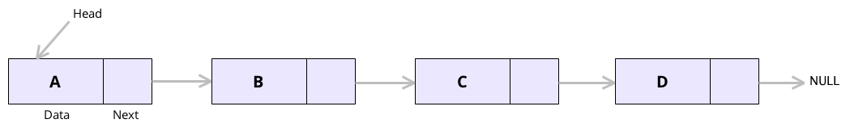
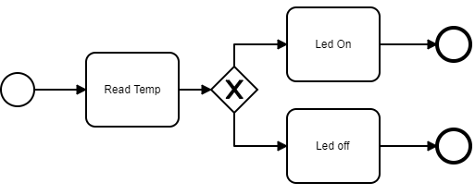
Translation - Convert BPMN to code
Phase 1: Define a compiling order base case
Problem? The input information doesn’t have an order.

Slide 14
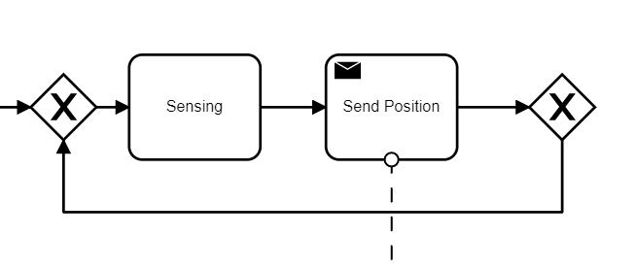
Loop Managing
Solutions?
Temporary arraylist
If an elements is repeated -> loop
If the process ends -> remove elements until the beginning of the arraylist or until the last diramation.

Slide 15
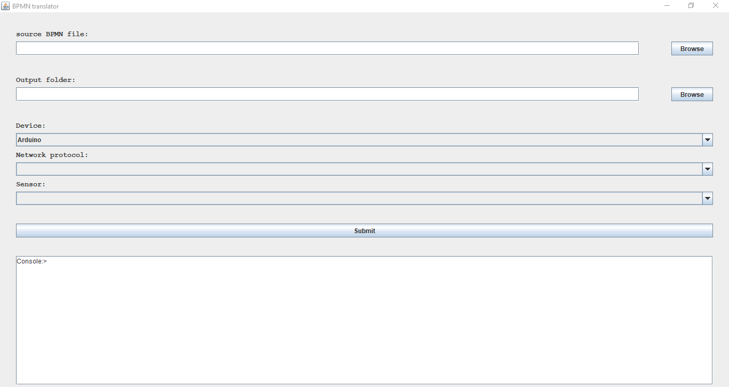
Code Generation & software usage
The last step is the code generation.
One file for every device + one library.

Slide 16
Compatible devices and limitations
Sensors:
Led diode
Temperature
DHT11
DHT22
TEMP36
Gas
MQ9
Light
LM358
Distance
HC-SR04
HY-SRF05
Shields:
ESP32
ESP8266
MKR1010
W5100
Limitations:
Compatibility with the sensor listed
Configuration language limit
BPMN event managing
Network Protocols:
MQTT
HTTP
Devices:
Arduino

Slide 17
Conclusion
The goal has been reached
Future Developments
Code Optimization
Add new sensors, protocols and devices
Event managing
Increase Domain
Add a GUI for the configuration managing
Automatic translation of .bpmn files in .translator files

Slide 18
Thanks for the attention

